Slide 1
Assignment 2 Framework & Rest
Presented by Team Daffodil
Mohhamd Arif Istiaq (A17CS4028)
Md Belal Hossain Santo (A17CS5038)
Tanvir Ahammad Moon (A19EC4023)
Lim Bao Ren (A18CS0099)
Azmil Azizi Bin Nordin (A18CS0041)

Slide 2
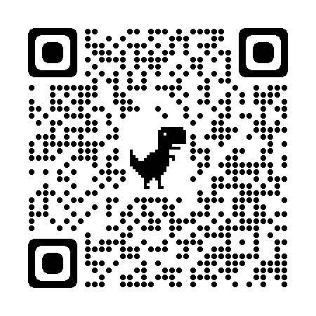
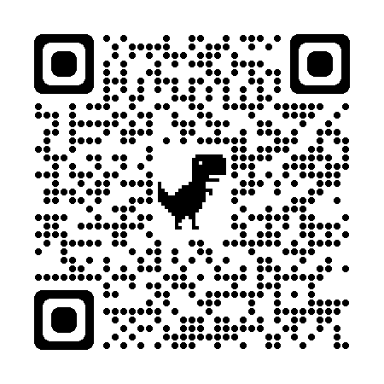


Table of Contents
01
02
03
FRAMEWORK
RESTFUL API
FUNCTIONALITY
Explain how to setup Express JS framework for RESTful API
Explain the results of the Rest API using Rest Client
Explain how to use RESTful API for the front end
Deploy Website
Front End: https://xdman1003.github.io/SC-Daffodil-Assignment2/FrontEnd/
Back End: https://us-central1-pestatanglungstore.cloudfunctions.net/api/store
https://github.com/XDMAN1003/SC-Daffodil-Assignment2
https://youtu.be/e0ufvm5VXNo

Slide 3
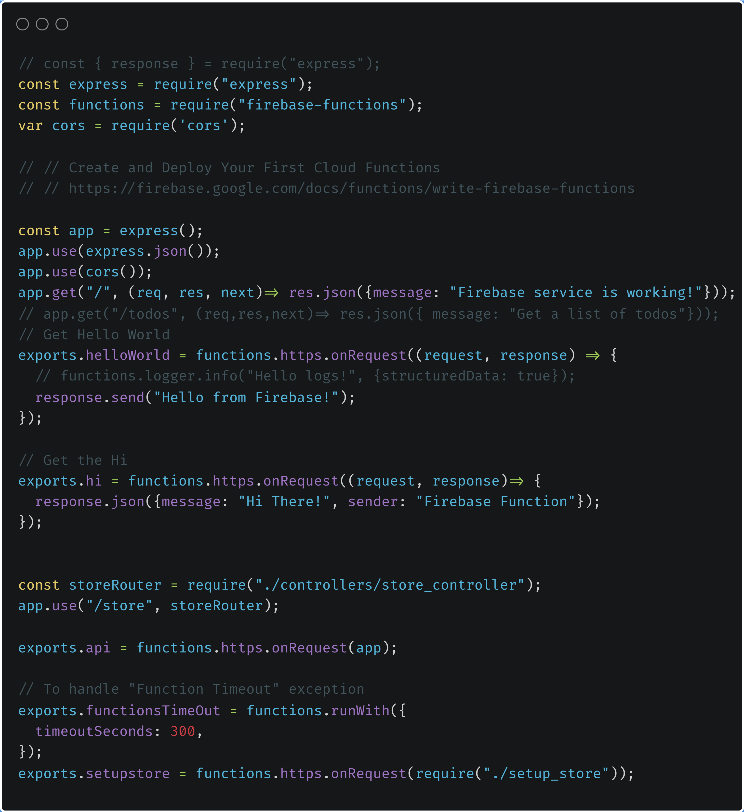
01
FRAMEWORK
Explain how to setup Express JS framework for RESTful API

Slide 4
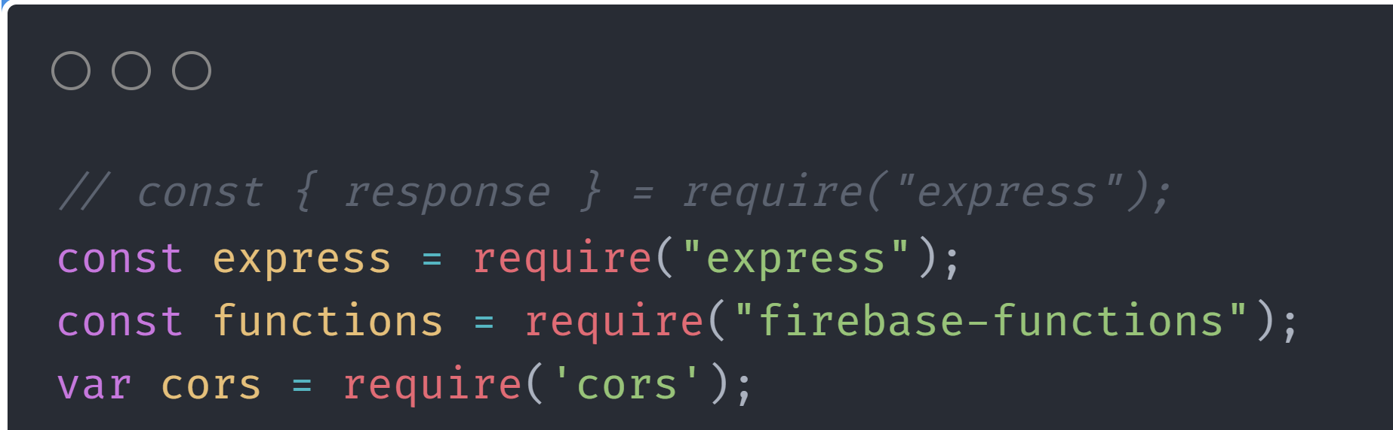
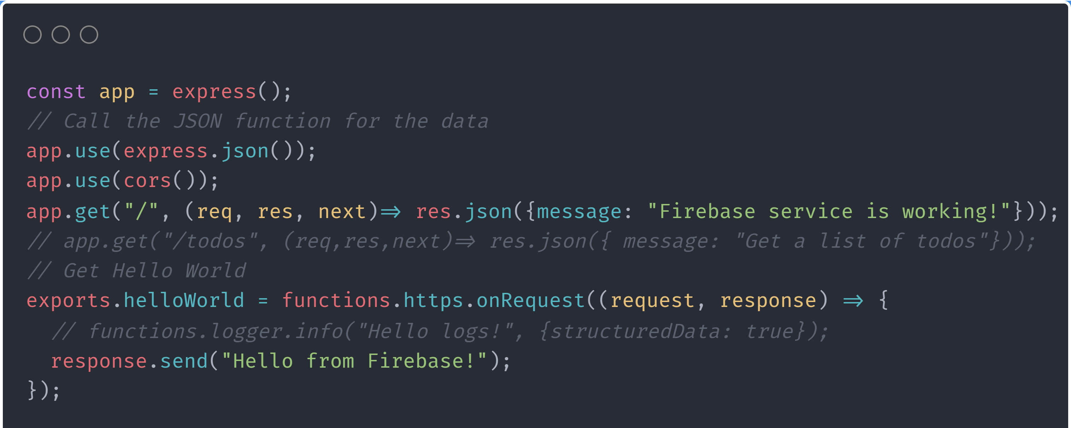
FRAMEWORK
FRAMEWORKG
“express” means use Express JS as the framework
“firebase-functions” means use Firebase as backend service
“cors” means need the function for Cross-Origin Resource Sharing
Initial Setup for Express JS
Example Functions
2 Functions created to use for TESTING
Function 1: https://link/ Test the database connection whether is success or failed
Function 2: https://link/helloWorld Test the function can send the message from the server
Function 1: https://us-central1-pestatanglungstore.cloudfunctions.net/
Function 2: https://us-central1-pestatanglungstore.cloudfunctions.net/helloWorld
Deployed Functions

Slide 5
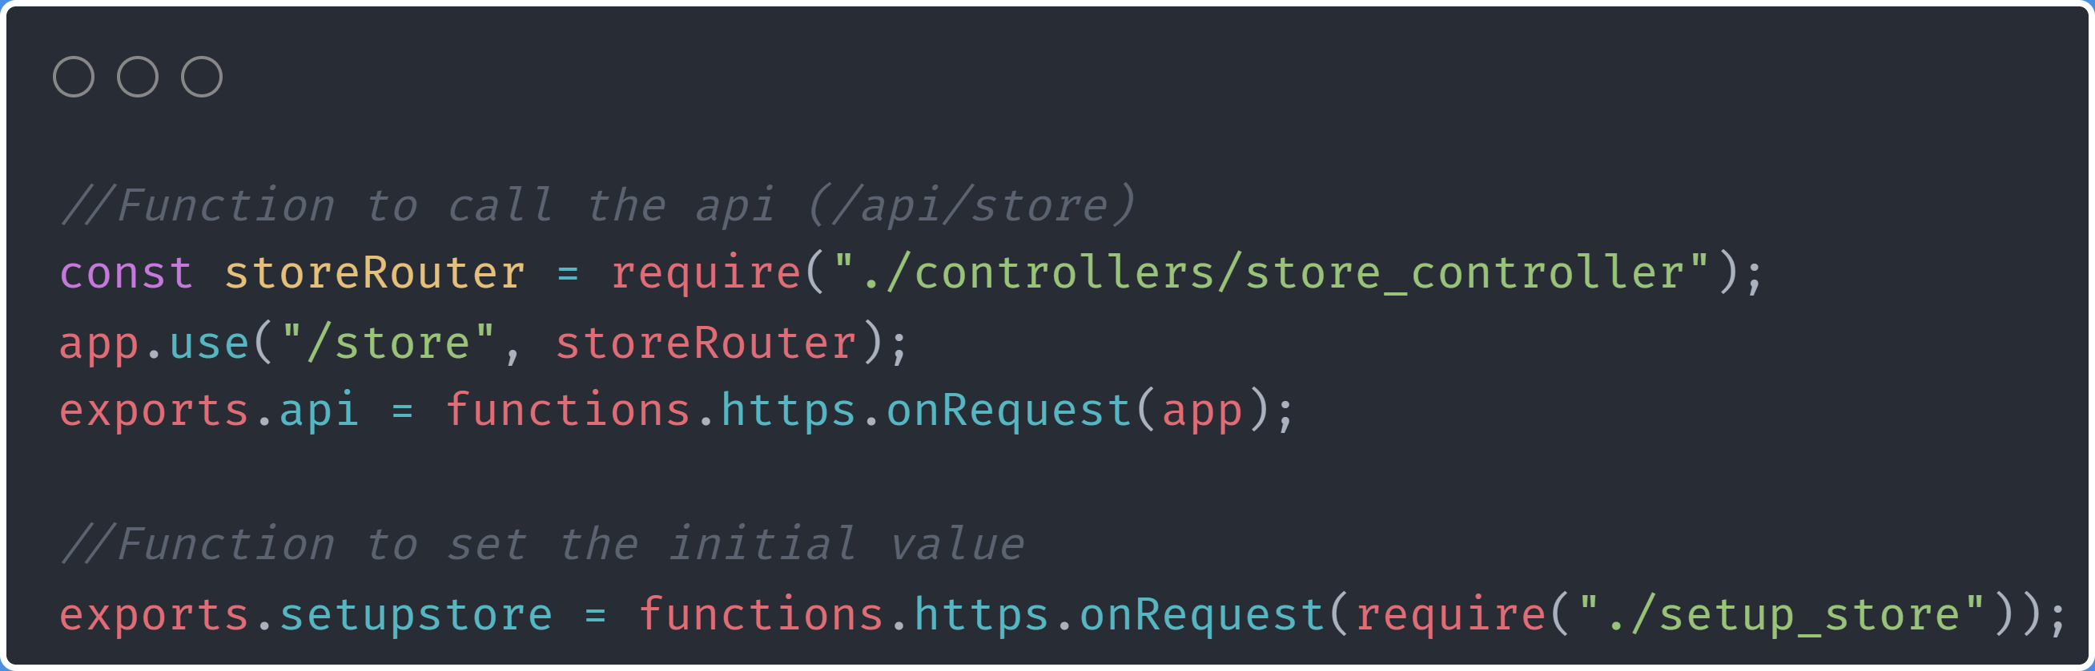
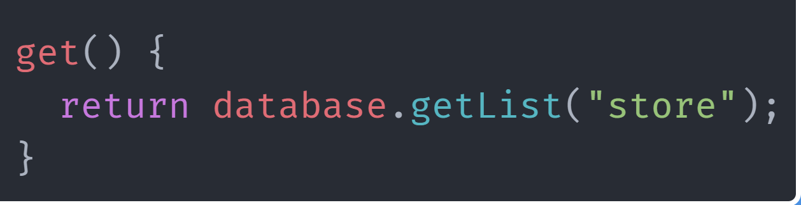
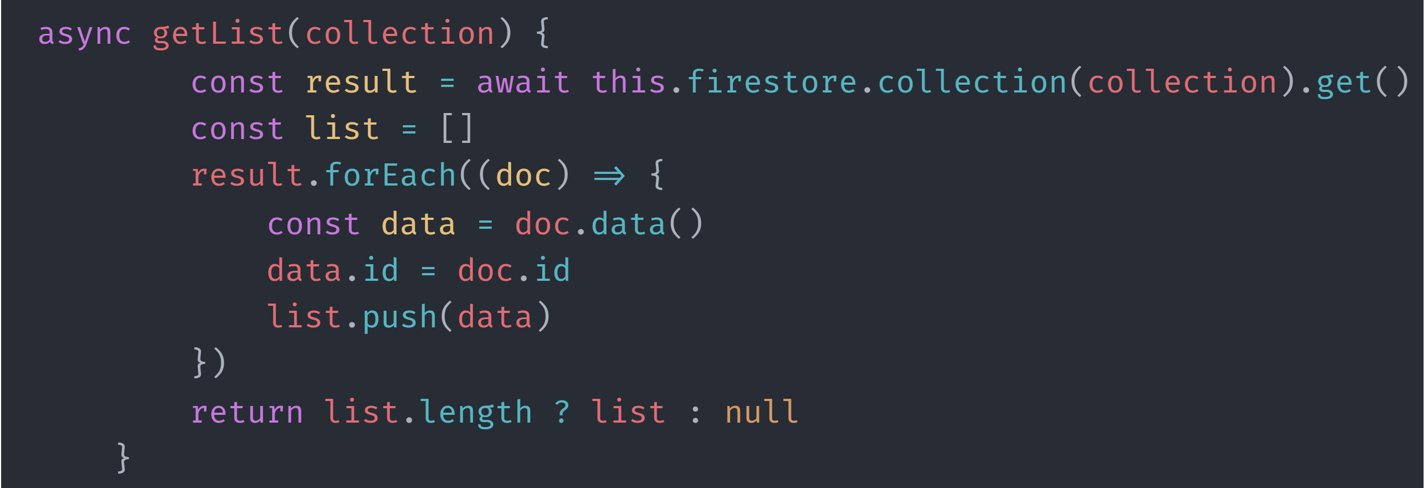
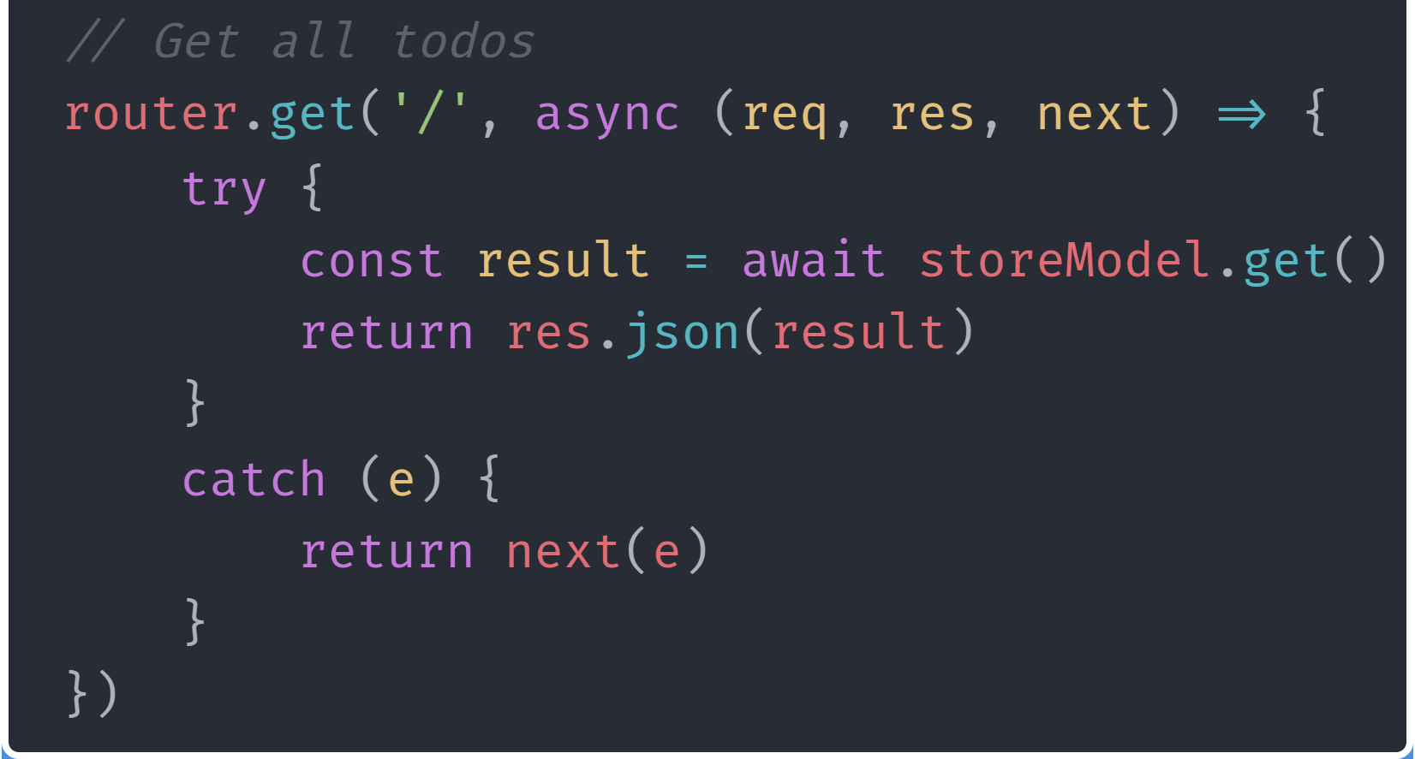
FRAMEWORK
FRAMEWORKG
Route the store controller and merge it with API group: https://link/api
Function to initiate the value in the database : https://link/setupstore
Setup in index.js (Main)
GET the list of Items
Model: store_model.js
Controller: store_controller.js
GET the list of items (Example Link)
https://us-central1-pestatanglungstore.cloudfunctions.net/api/store

Slide 6
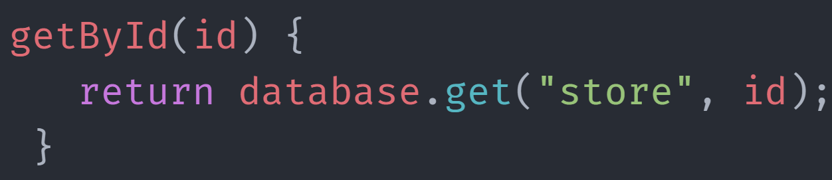

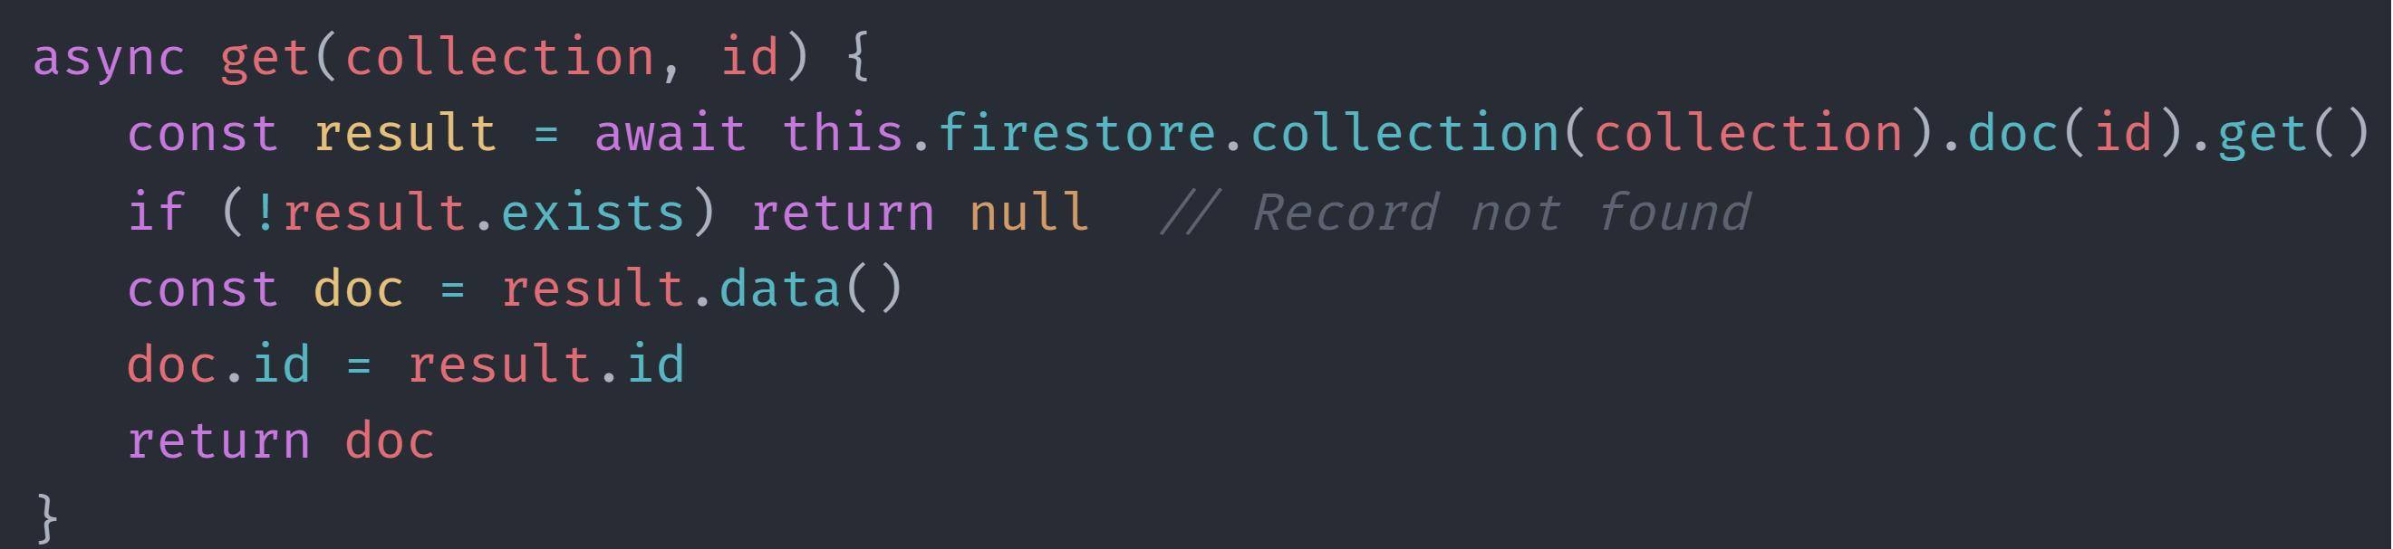
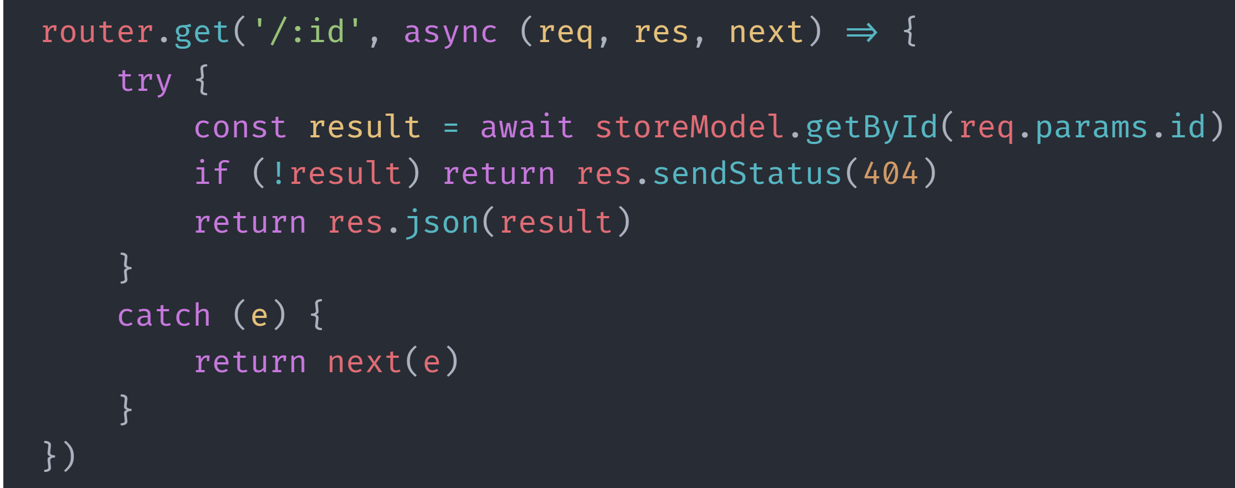
FRAMEWORK
GET single item
Model: store_model.js
Controller: store_controller.js
GET single item
Ex. {{title: 'A4 Paper (Red)', quantity: '20', id: '0dbAWTs7T6KAgT73n7tv'}}
Example Link
https://us-central1-pestatanglungstore.cloudfunctions.net/api/store/0dbAWTs7T6KAgT73n7tv

Slide 7
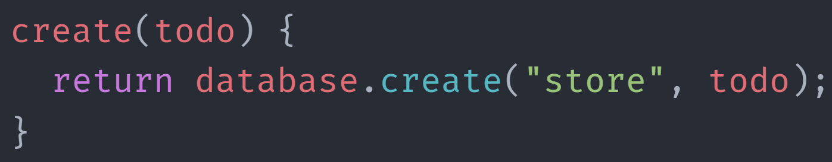
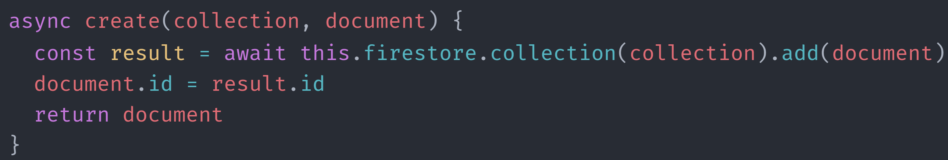
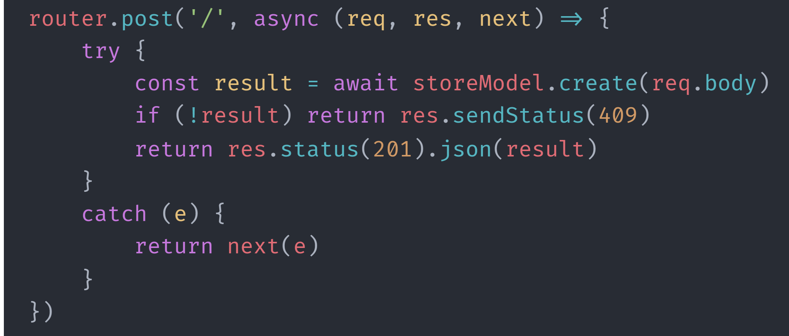
FRAMEWORK
POST item
Model: store_model.js
Controller: store_controller.js
POST item
Use POST method to call API
Simple Input Data: {title: 'A4 Paper (Red)', quantity: '20'}
Example Link
https://us-central1-pestatanglungstore.cloudfunctions.net/api/store

Slide 8
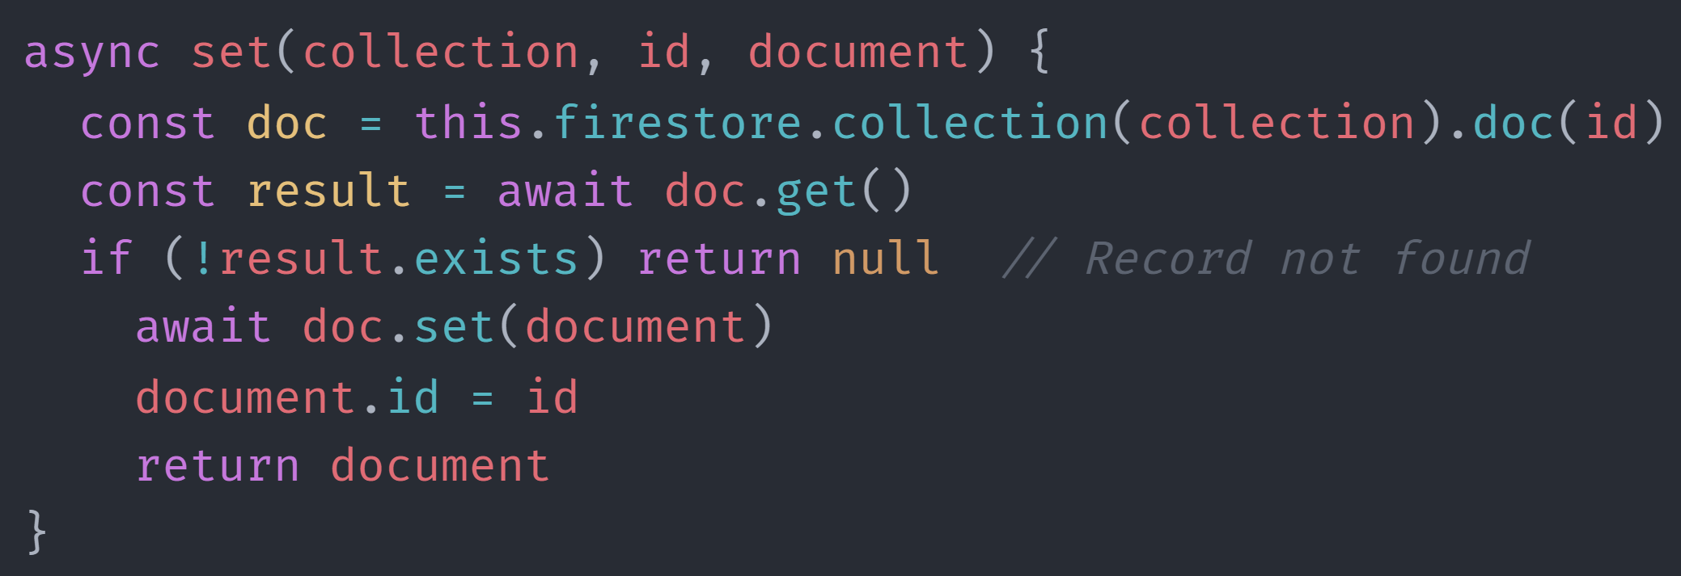
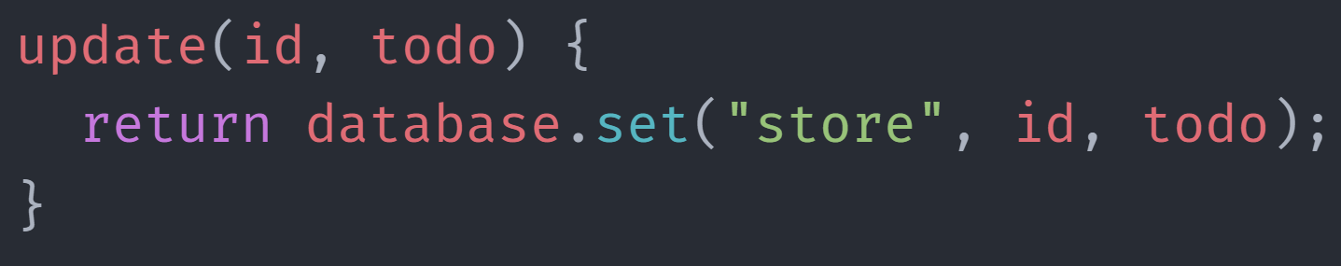
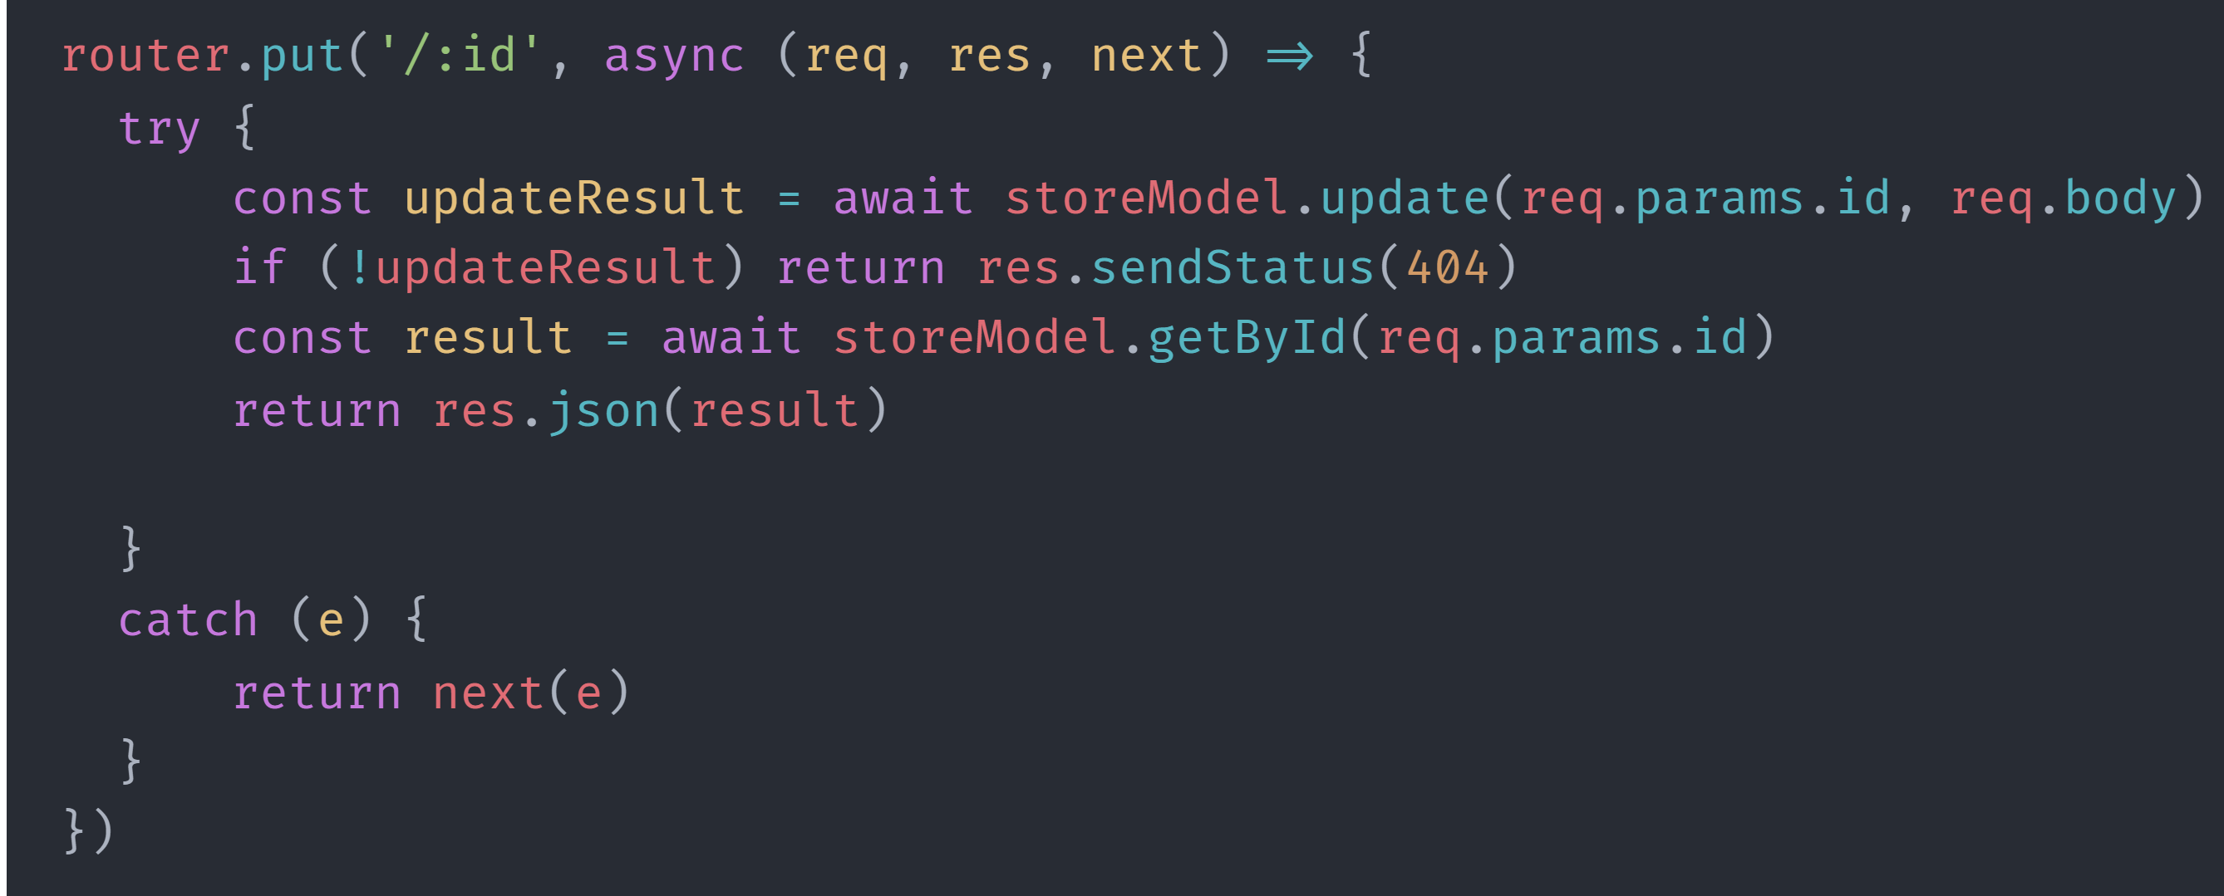
FRAMEWORK
PUT item (Edit Item)
Model: store_model.js
Controller: store_controller.js
PUT item
Use PUT method to call API (Must have ID)
Simple Input Data: {title: 'A4 Paper (Red)', quantity: '20'}
Example Link
https://us-central1-pestatanglungstore.cloudfunctions.net/api/store/0dbAWTs7T6KAgT73n7tv

Slide 9
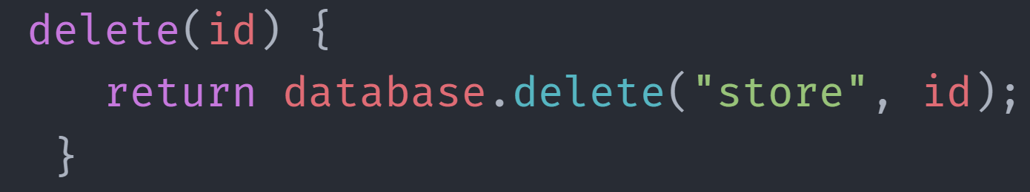
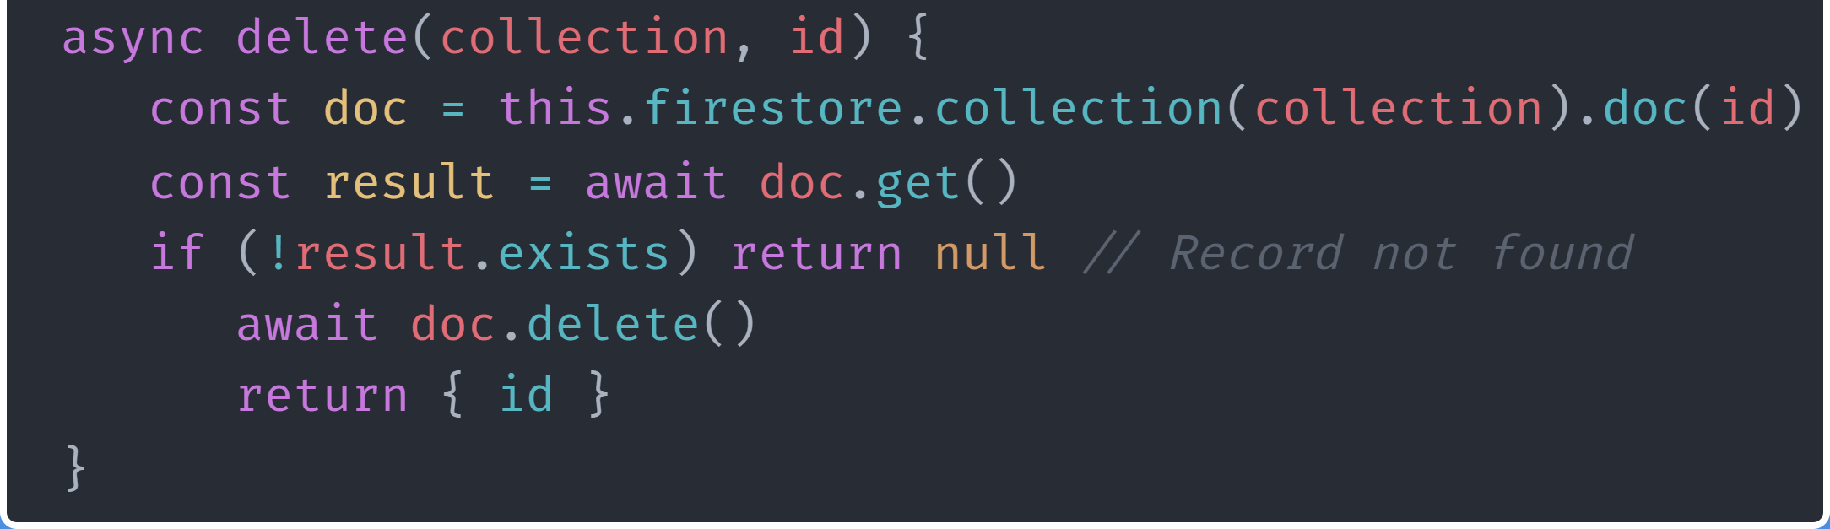
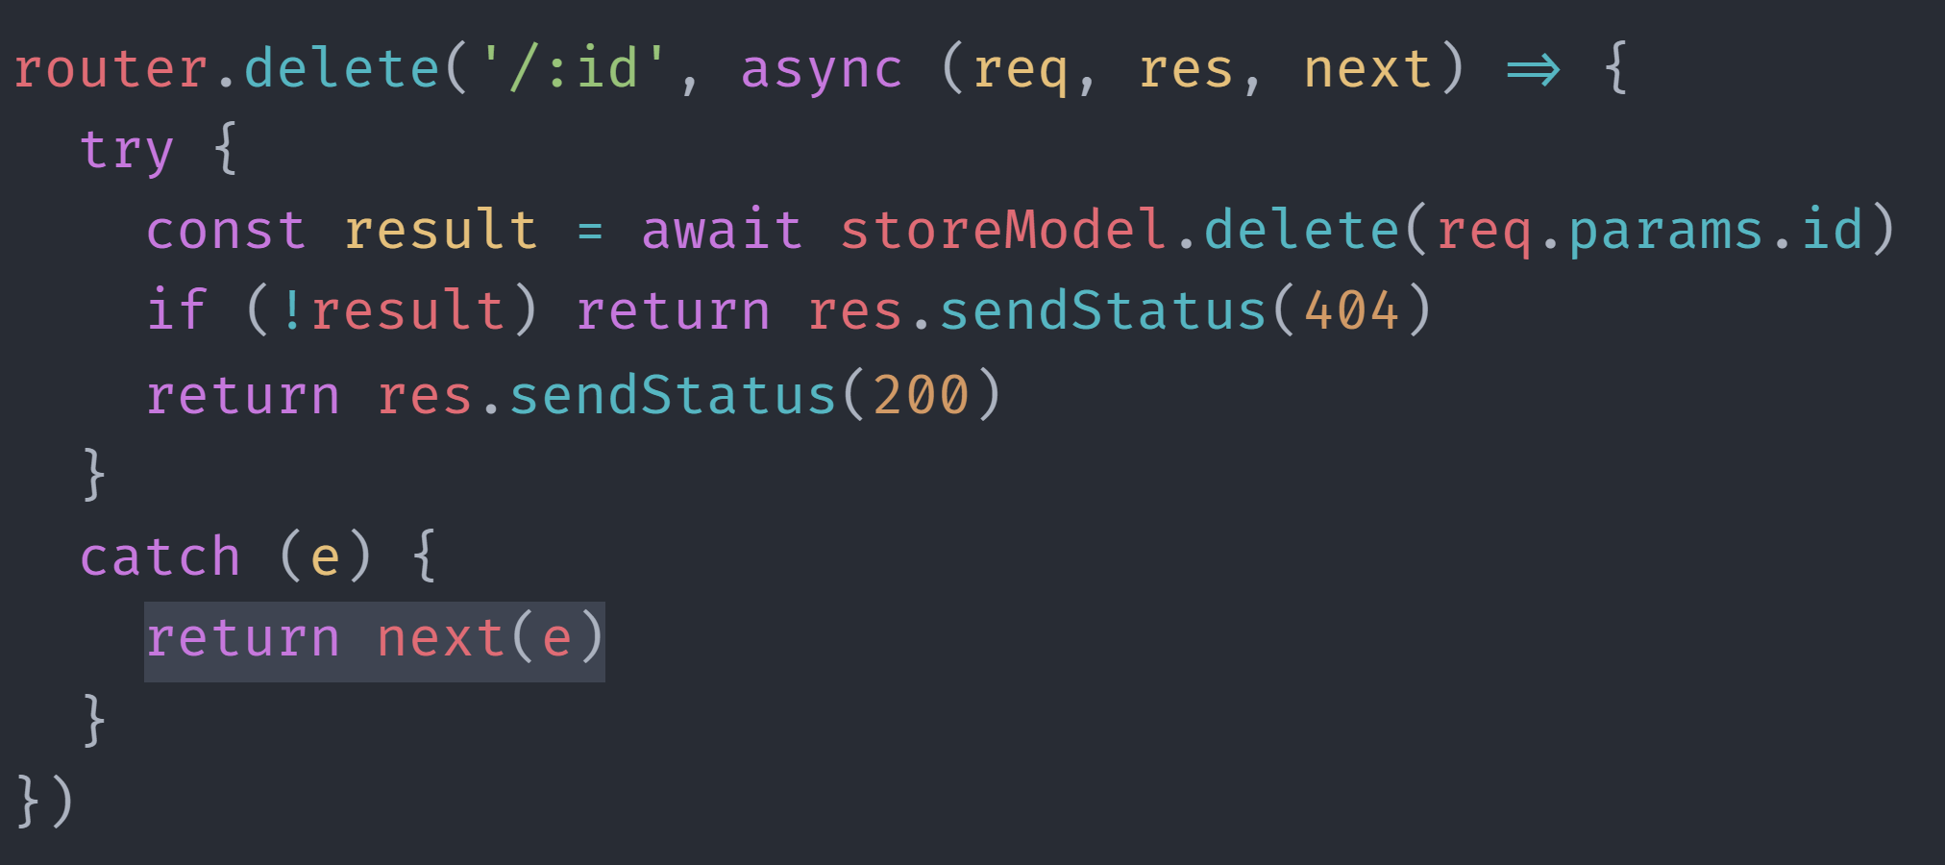
FRAMEWORK
DELETE item
Model: store_model.js
Controller: store_controller.js
DELETE item
Use DELETE method to call API (Must have ID)
Example Link
https://us-central1-pestatanglungstore.cloudfunctions.net/api/store

Slide 10
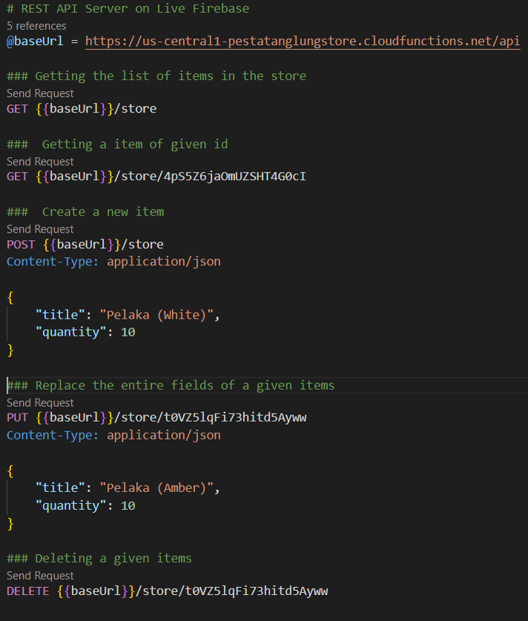
02
RESTFUL API
Explain the results of the Rest API using Rest Client

Slide 11
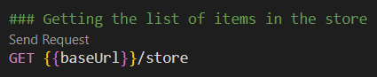
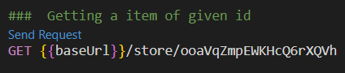
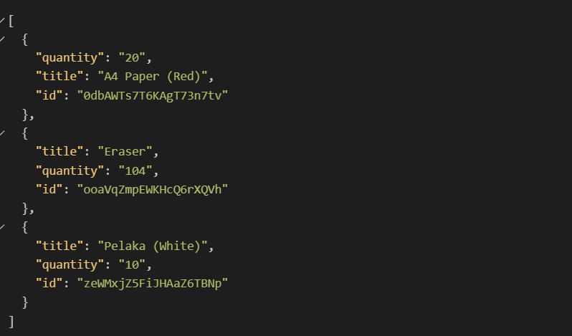
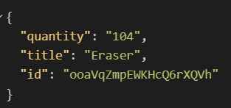
FRAMEWORK
@baseUrl = https://us-central1-pestatanglungstore.cloudfunctions.net/api
GET (List of items)
GET (Single Item)

Slide 12
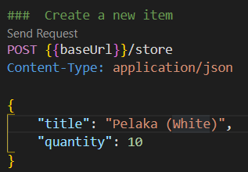
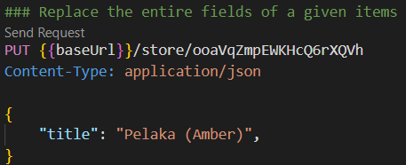
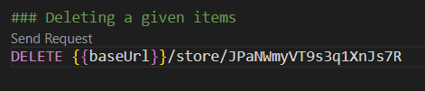
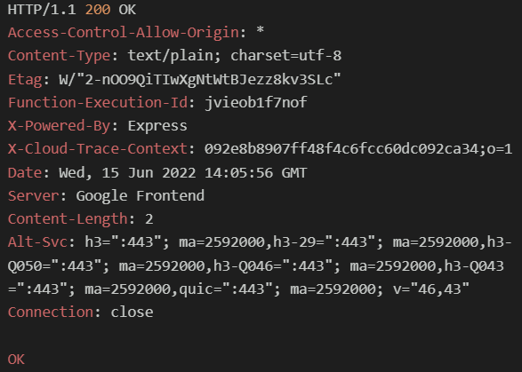
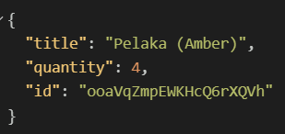
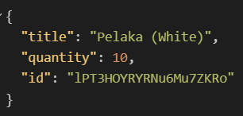
FRAMEWORK
@baseUrl = https://us-central1-pestatanglungstore.cloudfunctions.net/api
POST item
PUT item
DELETE item

Slide 13
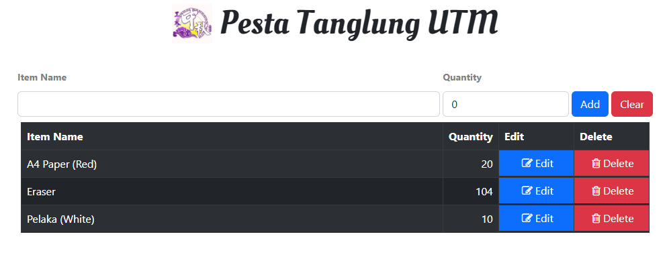
03
FUNCTIONALITY
Explain how to use RESTful API for the front end

Slide 14
03
FUNCTIONALITY
Explain how to use RESTful API for the front end

Slide 15
POST item
GET (List of items)
PUT item
DELETE item

Slide 16
Thank You
Presented by Group Daffodil

